Slide 1
Partitioning Random Geometric Graphs into Bipartite Subgraphs: Modeling Backbone Determination in Wireless Sensor Networks
A term project of the CSE 7350 Algorithm Engineering class
Bobby B. Lyle School of Engineering
Southern Methodist University
Presenter: Zizhen Chen (Z)
Email: zizhenc@smu.edu
Office: 308 Caruth Hall

Slide 2
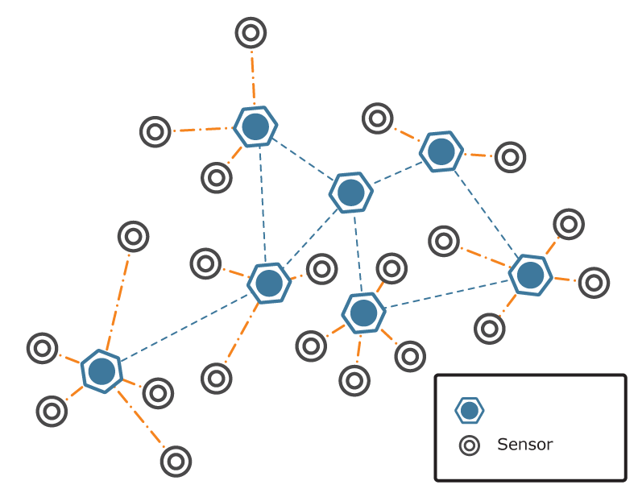
Wireless Sensor Networks (WSN’s)
Wireless Sensor Networks
Relay Node
(Routing)
2

Slide 3
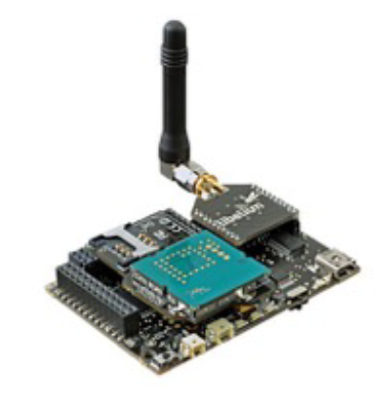

Wireless Sensor Networks (WSN’s)
Wireless networks of thousands of inexpensive miniature devices capable of computation, communication and sensing.
Their use throughout society “could well dwarf previous milestones in the information revolution” .
Let’s pronounce “motes”.

Slide 4
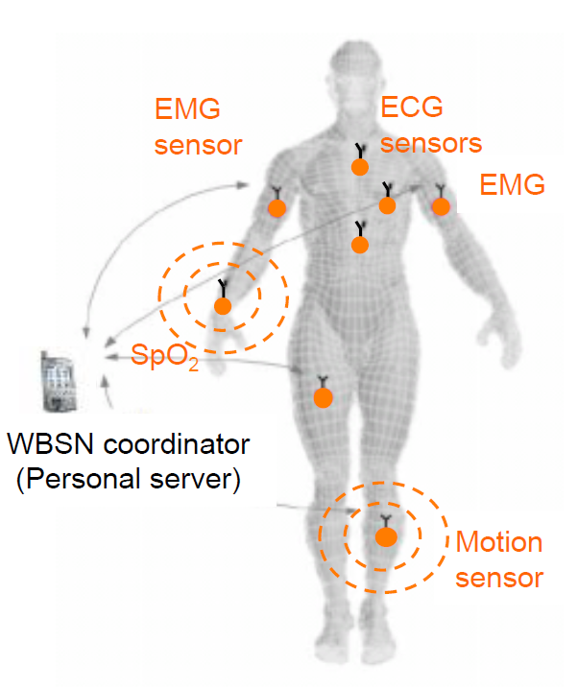
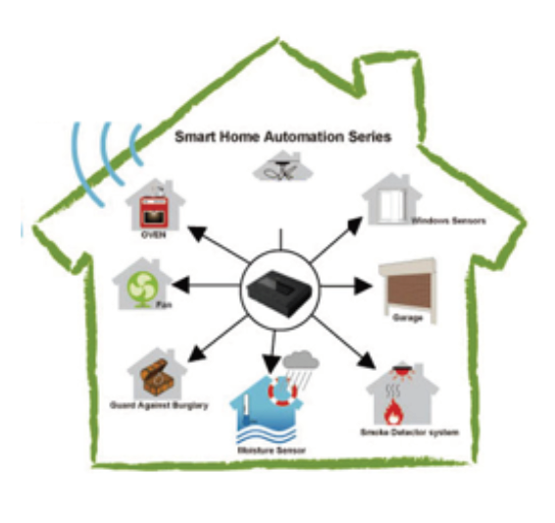
WSN’s Applications

Slide 5
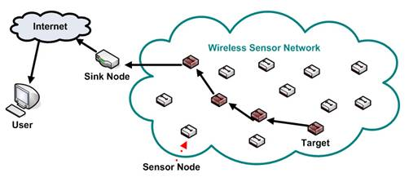
General Structure of a WSN System

Slide 6
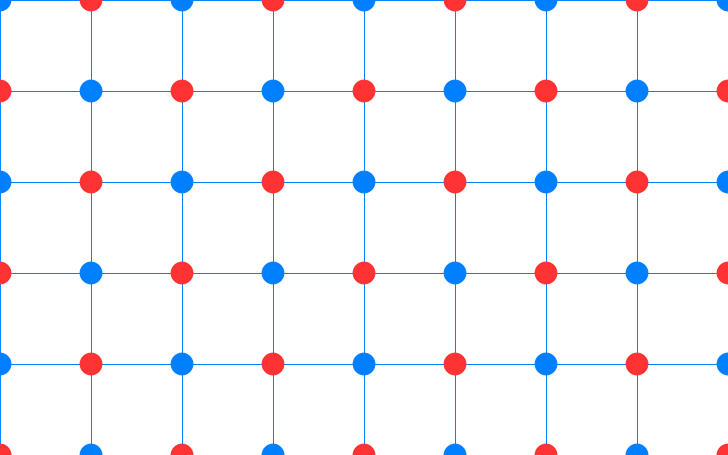
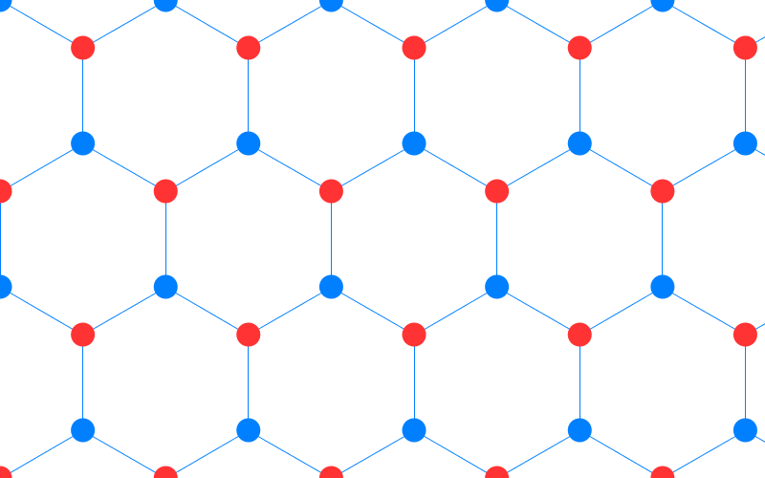
What is the Challenge?
Given numerous randomly placed wireless sensors, how can we organize them into multiple communicating network grids (backbones) each covering the region.
Three fixed deployment solutions:
Cartesian Lattice
Hexagonal Lattice
Bi-regular 3, 4 Lattice

Slide 7
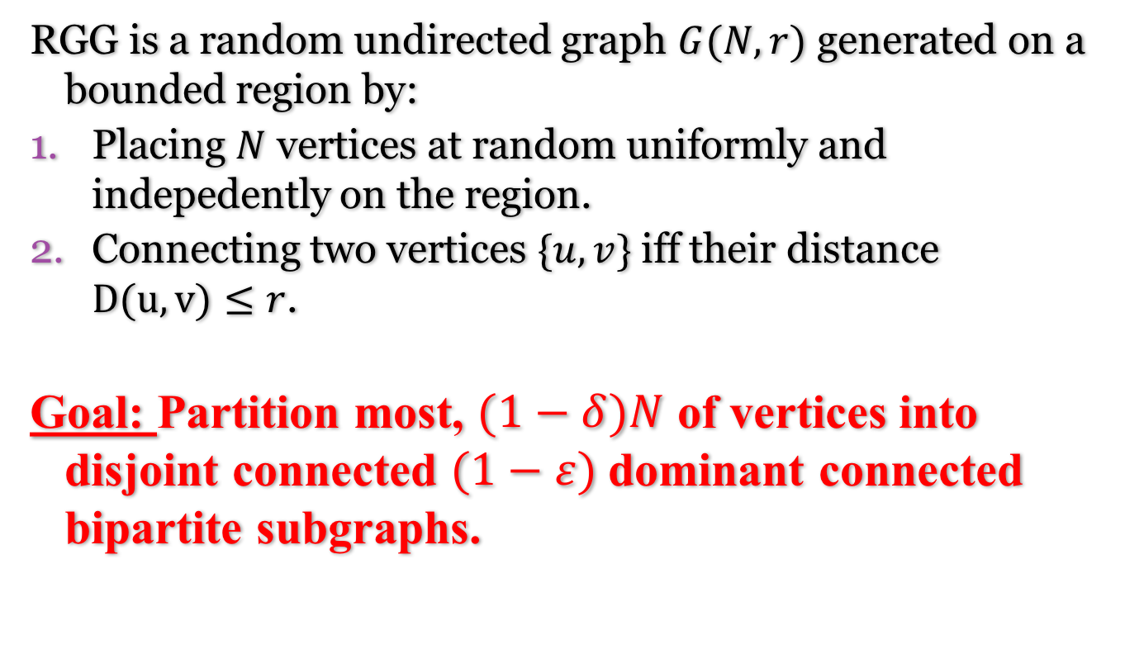
Random Geometric Graph (RGG)
RGG is a random undirected graph $G(N, r)$ generated on a bounded region by:
Placing $N$ vertices at random uniformly and indepedently on the region.
Connecting two vertices $\{u, v\}$iff their distance $D(u, v)≤r$.
Goal: Partition most, $(1−δ)N$ of vertices into disjoint connected $(1−ε)$dominant connected bipartite subgraphs.
Notes:
Smalle connected set of sensors which can relay message to other sensors. Monitor such as temperature, sound, pressure, etc

Slide 8
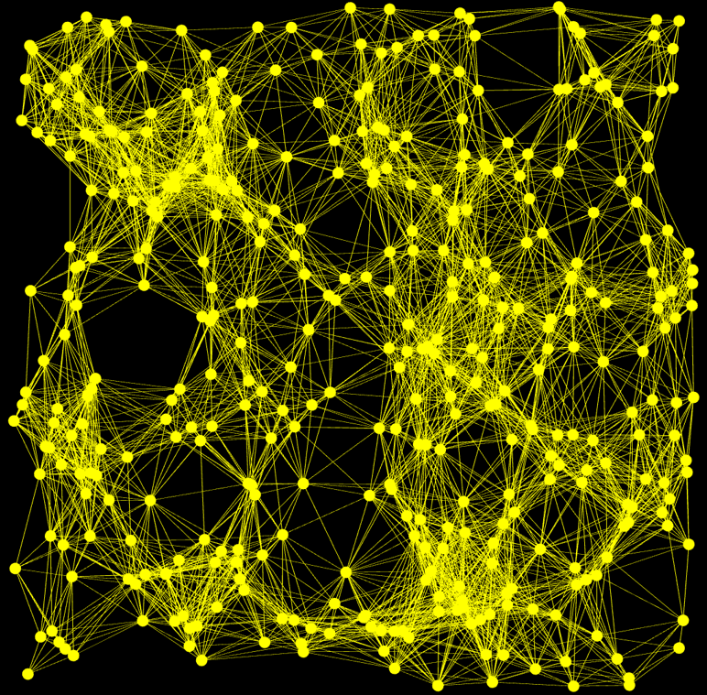

Example: RGG $G(400,0.15)$ on Unit Square
Edges: 5038
Max degree: 41
Min degree: 5
Avg. degree: 25.19

Slide 9
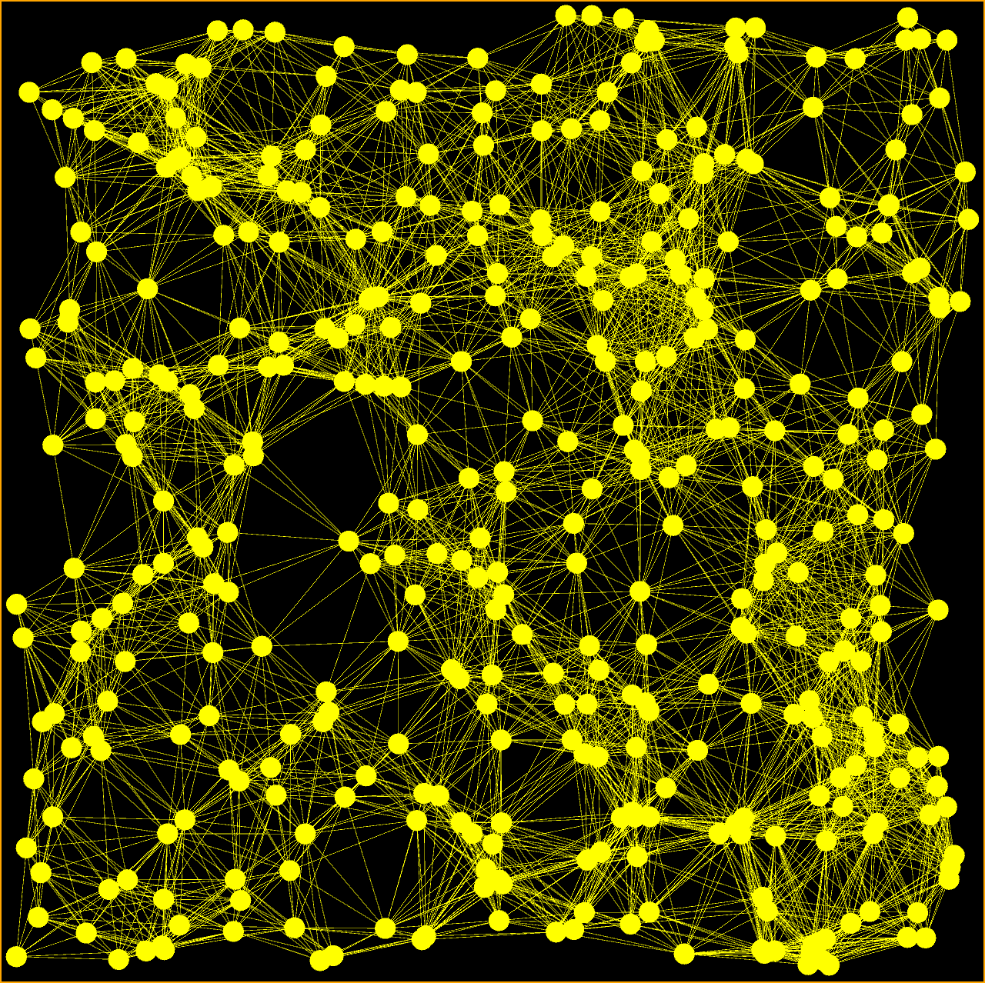
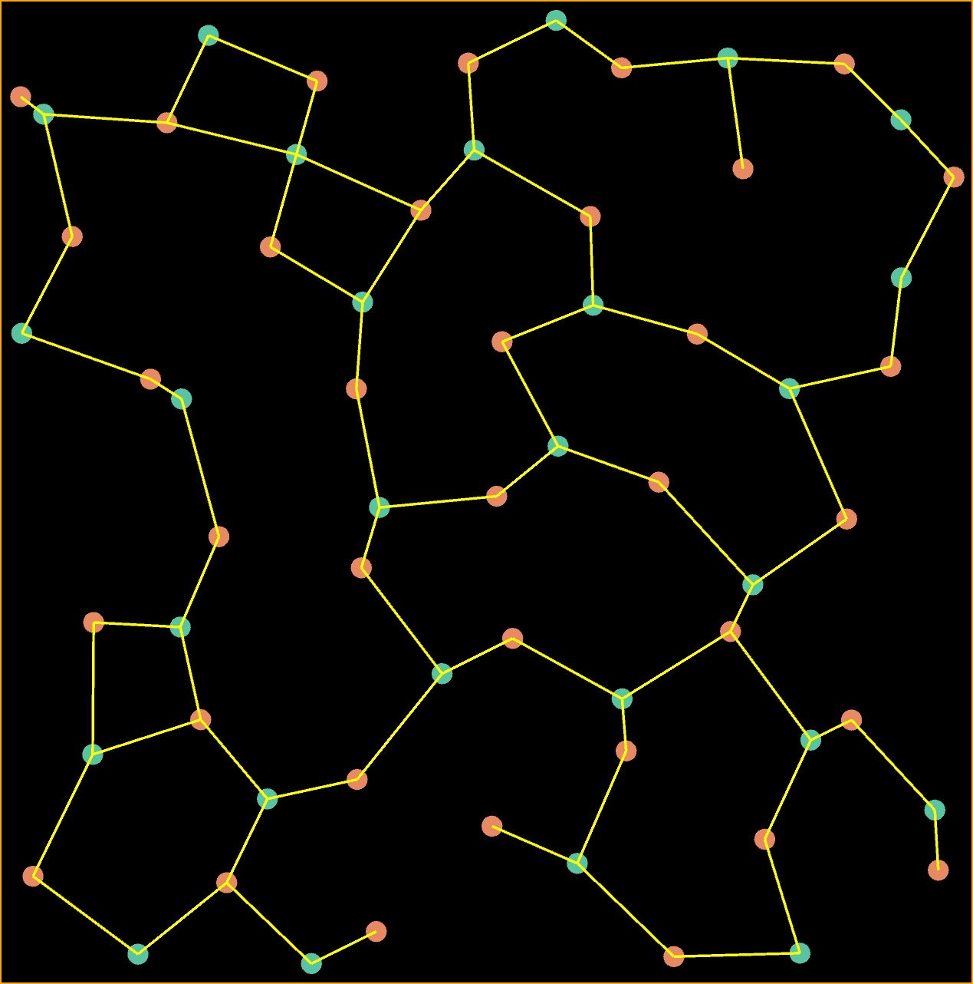
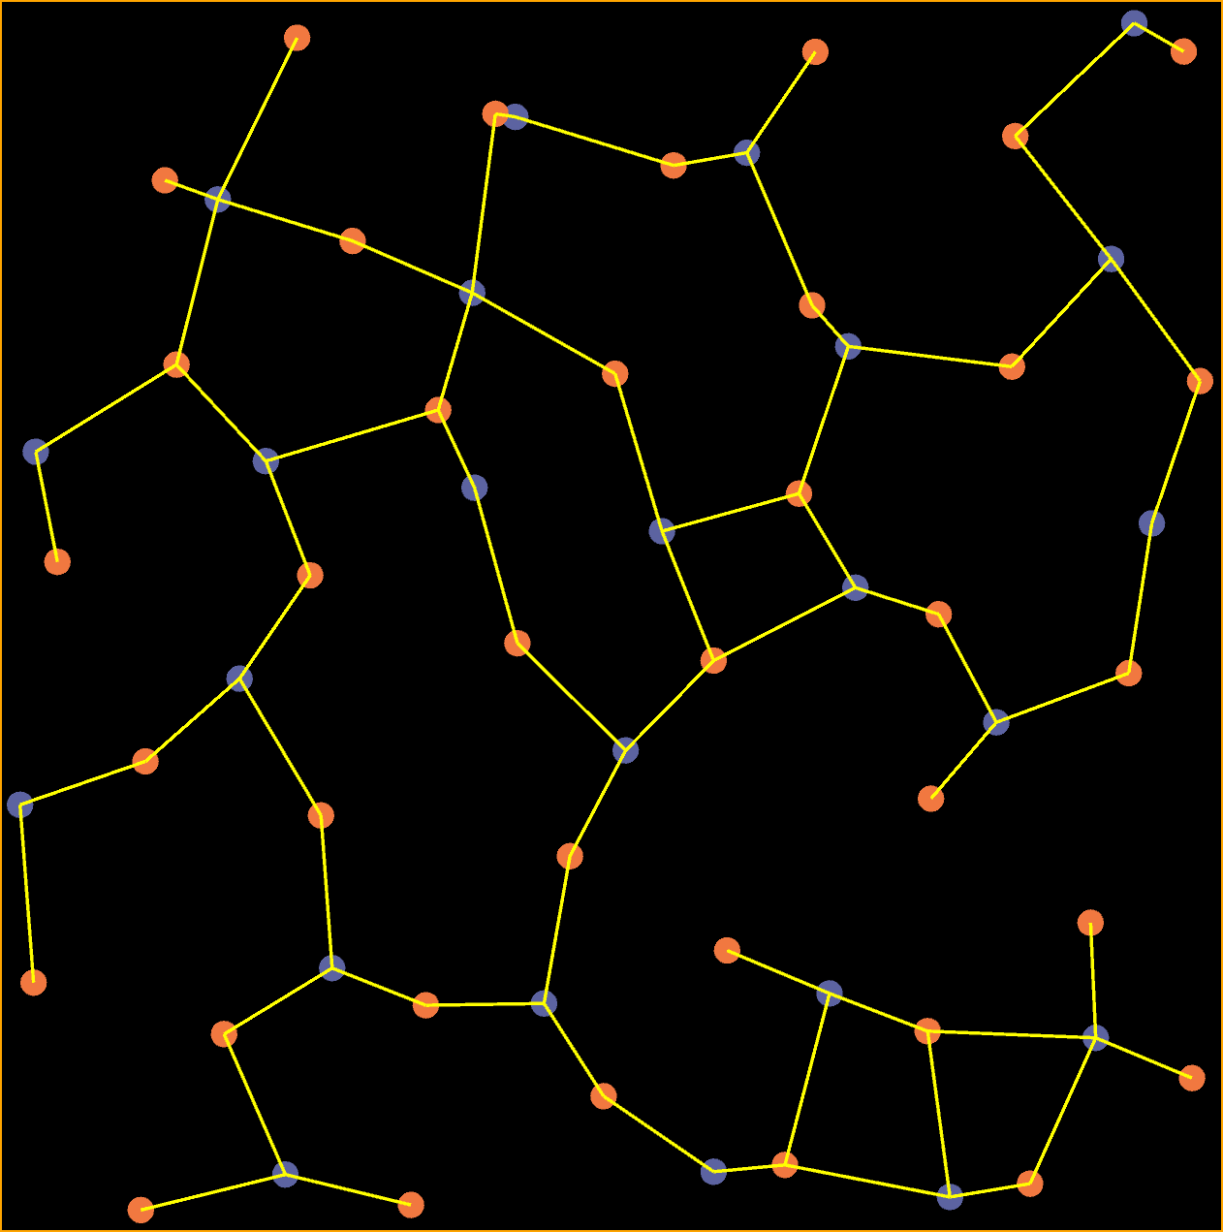
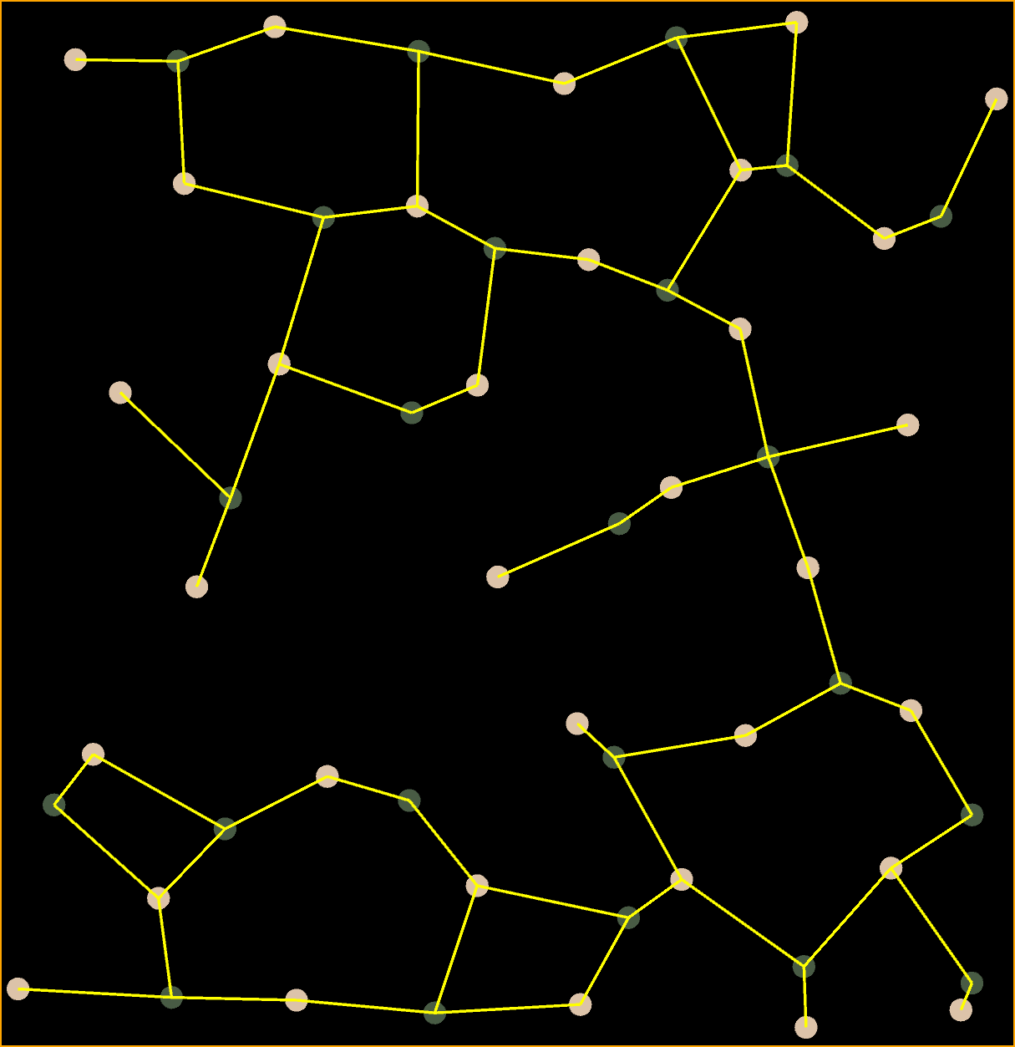
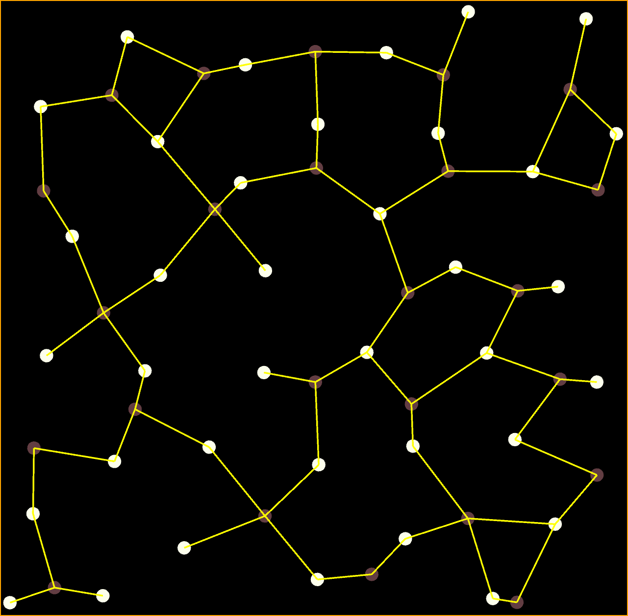
Partitioning RGG’s into Bipartite Subgraphs
Random Geometric Graph
Several Bipartite Subgraphs…
Notes:
This proposal is to study of the problem of efficient computation of a partition of a random geometric graph (RGG) into a limited number of densely packed bipartite subgraphs.

Slide 10
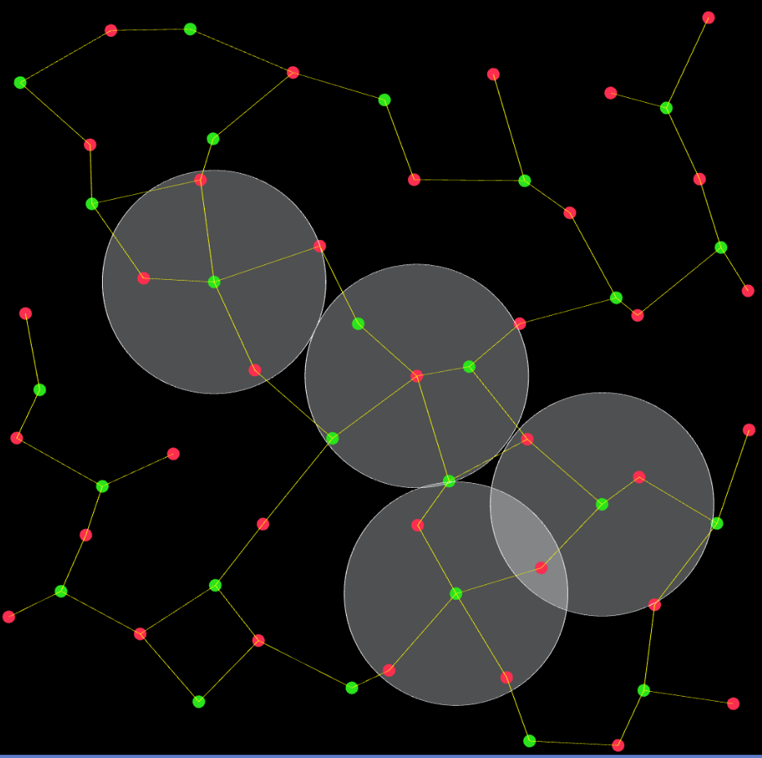
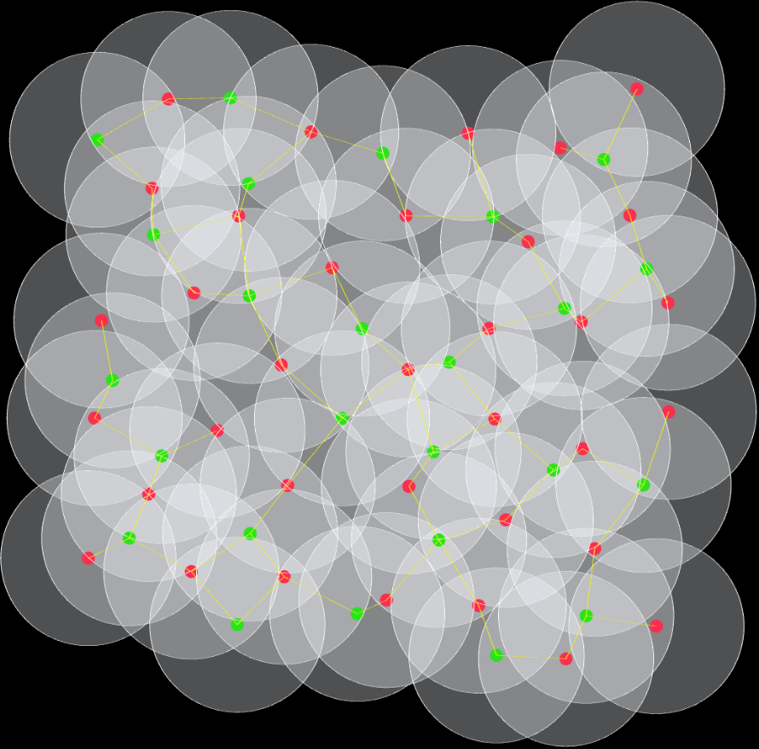
Example: Bipartite Subgraph and Coverage
Vertices: 61
Edges: 68
Avg. degree: 2.27
Covers almost all region

Slide 11
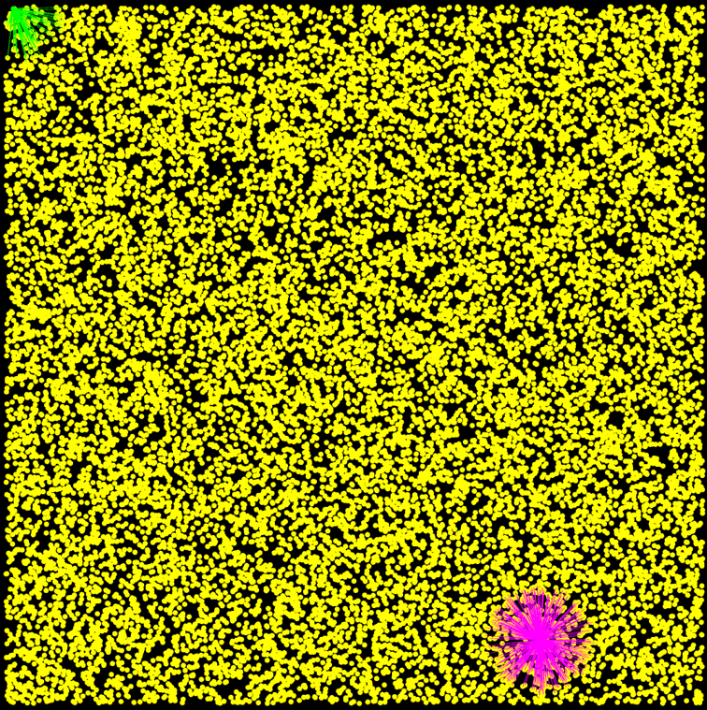

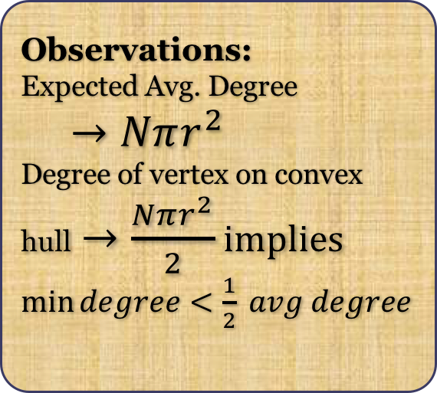
Example: Large Vertex Distribution G(20000, 0.08)
Edges: 3759504
Max degree: 467
Min degree: 96
Avg. degree: 375.95
Observations:
Expected Avg. Degree
$→Nπr^{2}$
Degree of vertex on convex hull$→\frac{Nπr^{2}}{2}$ implies
$\min{degree<\frac{1}{2} avg degree}$

Slide 12
Procedure
RGG generation.
Sequential coloring algorithms.
Determining backbones from possible bipartite subgraphs

Slide 13
Node Distribution
Topology:
Unit Square
Unit Disk
Unit Sphere (extra points)
Unit Square: a square whose sides have length 1.
Unit Disk: the set of points of distance 1 from a fixed central point (radius 1).
Unit Sphere: the set of points of distance 1 from a fixed central point (radius 1).

Slide 14
Node Distribution
Distribute N nodes in uniform-random way all over the region.
HOW?
Does different topologies matter the random distribution?

Slide 15
Coordinate Systems
Cartesian
Polar
Spherical

Slide 16
Egg Generation
Brute-force?
Sweep method.
Cell method.

Slide 17
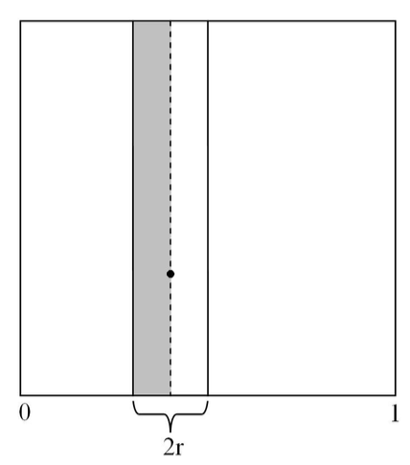
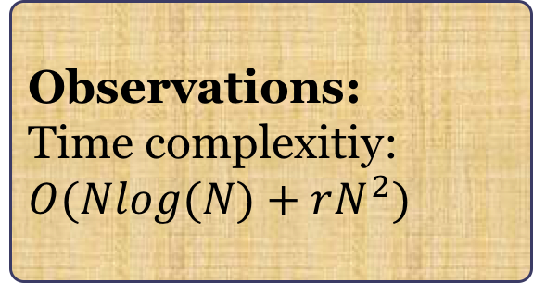
Sweep Method
Observations:
Time complexitiy: $O(Nlog(N)+rN^{2})$

Slide 18
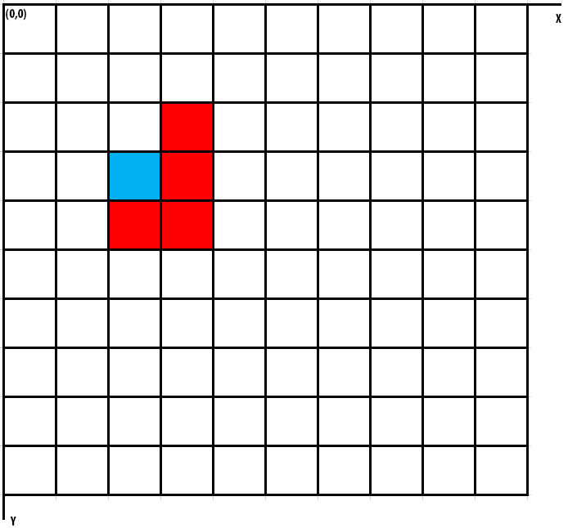
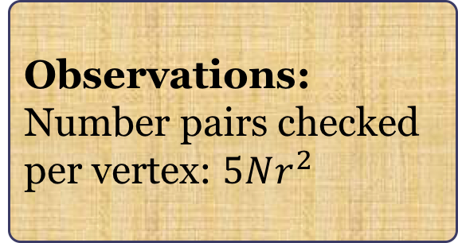
Cell Method Yields Edges in O(E)
Observations:
Number pairs checked per vertex: $5Nr^{2}$

